Slide 1


Hexagonal Architecture & Beyond
Thomas PIERRAIN
(use case driven)
@tpierrain
Notes:
Hello everyone. I’m truly happy to be among you today, in order to talk about this specific topic: Hexagonal Architecture (a.k.a. Ports & Adapters).
Hexagonal architecture (a.k.a. Ports and Adapters) is a fabulous pattern that has more advantages than the ones for which it has been originally created.
I’ve been using this pattern in production since more than 8 years. Many times, with many different contexts and teams.
One can think in an orthodox vision that patterns do not evolve. That it is important to keep Alistair Cockburn’s pattern like it was described back in the days.
One can think that some patterns may evolve, that Hexagonal Architecture has more facets than we think. We’ll see that all together today.

Slide 2
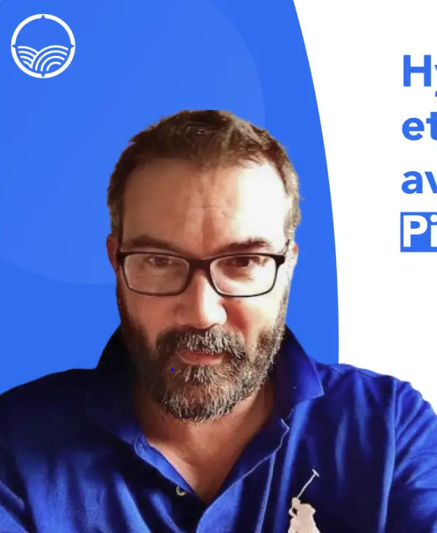
Hexagonal Architecture & Beyond
building software since 25 years
eXtreme Programmer now dealing with people after 12 years of architecture and change management
currently VP of Engineering @ Agicap in Lyon (scale up)
XP, TDD, DDD, Event Sourcing, Tech architecture, Reactive Programming
DDD FR organizer
Thomas PIERRAIN (use case driven)
Notes:
My name is Thomas PIERRAIN, I’ve been building software since 25 years approx. I’ve worked for many companies, industries, including video game, music, hospitality, health care… 12 years in finance (building low latency softwares), I’ve been developer, tech lead, staff engineer, software architect, technical architect, enterprise architect. 6 years ago I’ve created my own consulting company (42skillz) and last winter I sold my shares and join a European scale-up -Agicap- as their VP of Engineering. Our tech and product team had 150 people last month.Agicap solves the problem of how to manage your company’s cashflow in order to take good decisions (to recruit, to invests, etc). It’s a dashboard with real time monitoring, forecasting with scenarios etc. helping SMEs to steer their activity and business.Anyway. Before that I’ve made lots of dev as I was saying and I have a few centers of interest :
Domain Driven Design (I’m leading the french DDD user group since more than 6 years: DDD FR). We will talk a little bit about it today.
TDD and all the XP practices
Reactive programming & Low latency systems
Event sourcing (including bi-temporal one)
Technical Architecture
And of course: Hexagonal Architecture which i’m using in production since more than 8 years now. During all these years I’ve made talks about it, blog posts, multiple live coding sessions (including one with Alistair, the creator of the pattern. That you can find on yt: Alistair in the hexagone), I’ve organized panels with other expert, etc. Anyway : I really like this pattern and I’m deeply involved to make it understand by people (and especially in France) over the years.

Slide 3
Menu
Original pattern
Alternate takes (DDD friendly)
Notes:
This session will present both the original pattern in detail, and some alternative versions (related to Domain Driven Design).

Slide 4
Menu
Original pattern
Alternate takes (DDD friendly)
Notes:
Ok.Let’s start with the orginal pattern.

Slide 5
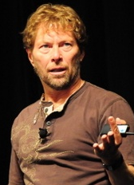
Hexagonal Architecture: origins
Smalltalk project (mid 90s): To be able to work 2 weeks without the database
Weather warning system: To be able to connect to multiple external systems (http, telemetry, phone, RSS, db) without changing the whole software every time
Alistair Cockburn
Notes:
Mid 90’: A project with smalltalk and a relationnal database. The guy coding the relational mapper said: « I’m sorry, stop the project: it won’t scale. We have to redesign. Everybody go home for 2 weeks ». Just give us a lay to fake the database
The Weather warning system made him to cope with Combinatorial explosion

Slide 6
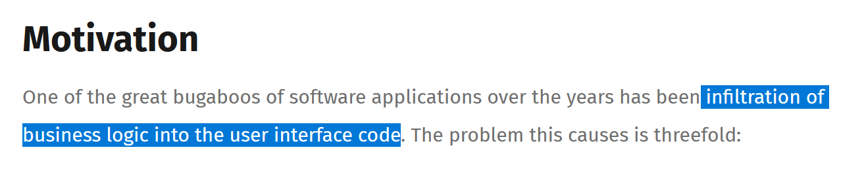
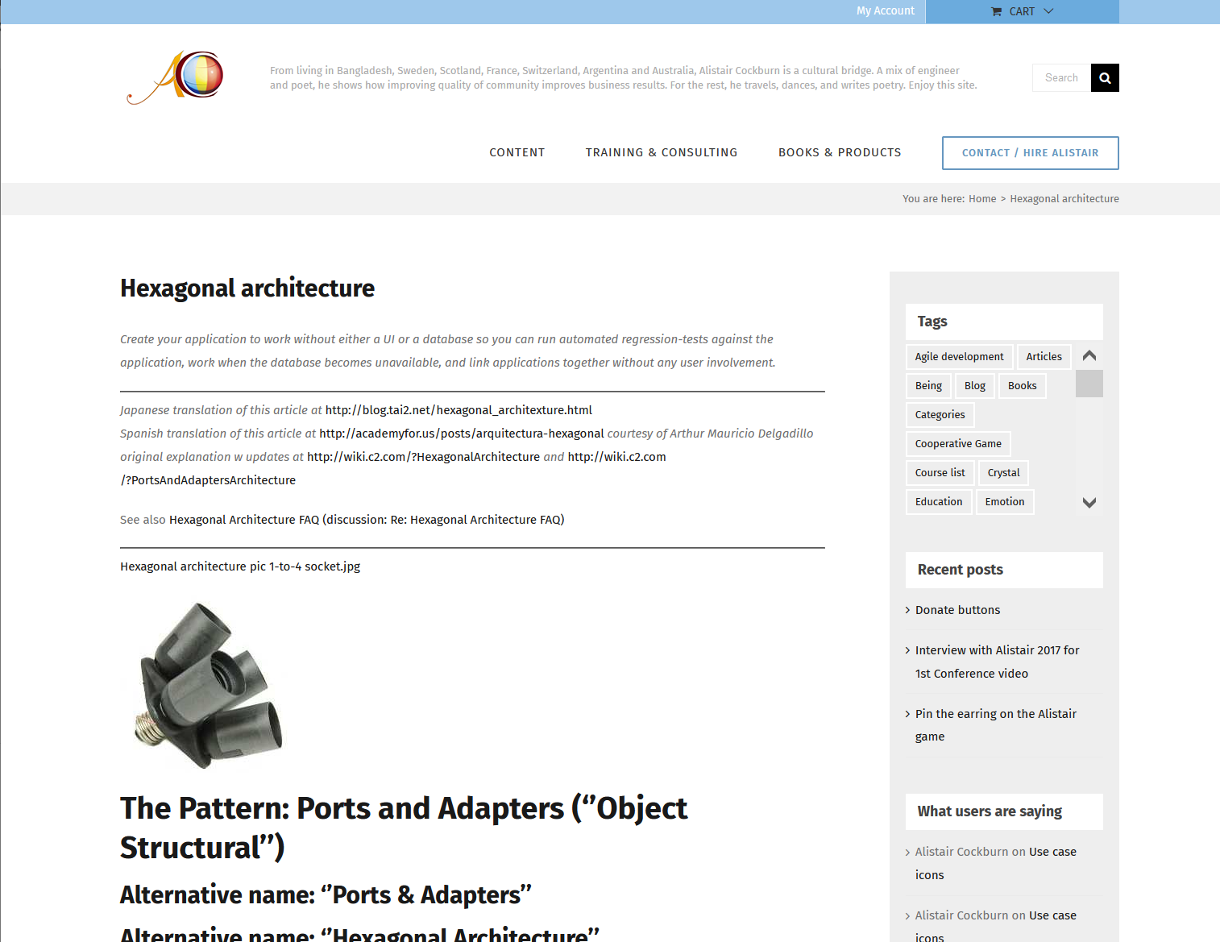
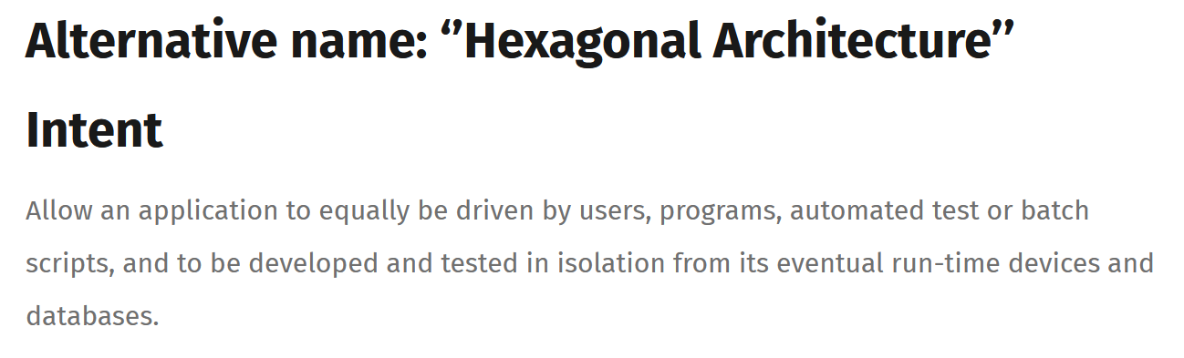
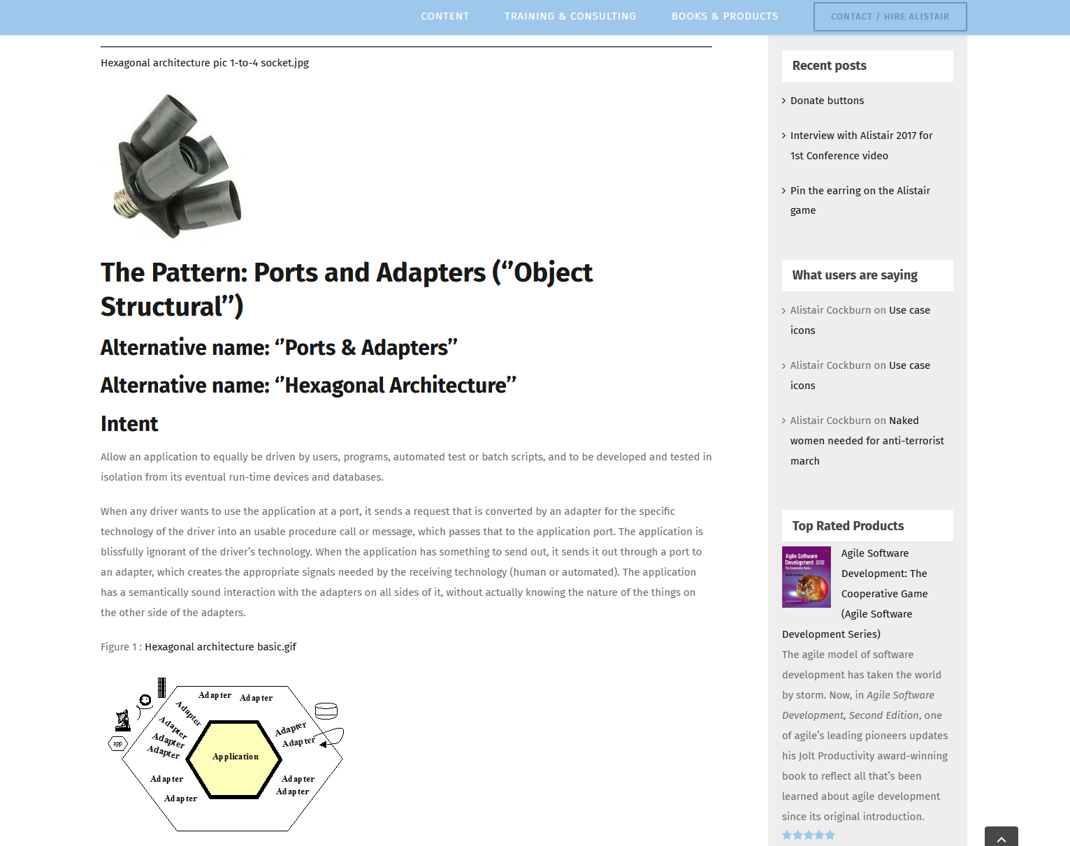
Hexagonal Architecture: one pattern to…
Alistair Cockburn

Slide 7
Hexagonal Architecture: Actually, one pattern to…
Easily switch one technology with another without breaking our core domain code (like plug-ins)
Easily develop and test an application in isolation from its eventual run-time devices and databases
Have good time to market and fast feedbacks about what is really at stakes for our users
Alistair Cockburn

Slide 8
2 Zones
INFRA
DOMAIN

Slide 9
Communicating via…
Ports
Adapters

Slide 10
Ports & Adapters
Domain
Ports in the domain

Slide 11
Ports & Adapters
Infrastructure
WebController (Adapter)
Adapter
(in proc)
Domain
Auditorium seating web Adapter
Ports in the domain
Adapters in the infra
Repository (Adapter)

Slide 12
dependencies Always towards the inside
Infra
Domain
Dependency inversion principle
A.k.a. Configurable dependencies

Slide 13
deeply asymmetrical
Data stores
External systems
APIs
👻
Left-side
(primary)
(driver)
Right-side (secondary)
(driven)
user

Slide 14
deeply asymmetrical
Left adapters
Infrastructure
Right-side Ports
WebController (Adapter)
Domain
« uses »
“implemented by”
“use”
“implements”
« uses »
« implements »
Auditorium seating web Adapter
« uses »
« implements »
Repository (Adapter)
Right Adapters
Left-side Ports
Right-side adapters

Slide 15
deeply asymmetrical
Left adapters
Infrastructure
Right-side Ports for OUR domain to interact with others
Left-side adapters translate tech to domain
WebController (Adapter)
Domain
« uses »
“implemented by”
“use”
“implements”
« uses »
« implements »
Auditorium seating web Adapter
« uses »
« implements »
Repository (Adapter)
Right Adapters
Left-side Ports
to enter our DOMAIN
Right-side adapters translate domain to tech

Slide 16
Ports are contracts
Infrastructure
WebController (Adapter)
« uses »
Domain
« implements »
Auditorium seating web Adapter
Left-side Ports are domain-driven Contracts for others to interact with us
Right-side Ports are domain-driven Contracts for us to ask something to someone else
« implements »
Repository (Adapter)

Slide 17

Hexagonal “Micro” services
@tpierrain (use case driven)
HTTP
Infrastructure
WebController (Adapter)
Seat suggestions Domain
(in proc)
Auditorium seating web Adapter
Auditorium seatings API
HTTP
Repository (Adapter)
Suggestions db
Seat Suggestions API

Slide 18
Hexagonal Architecture in motion

Slide 19
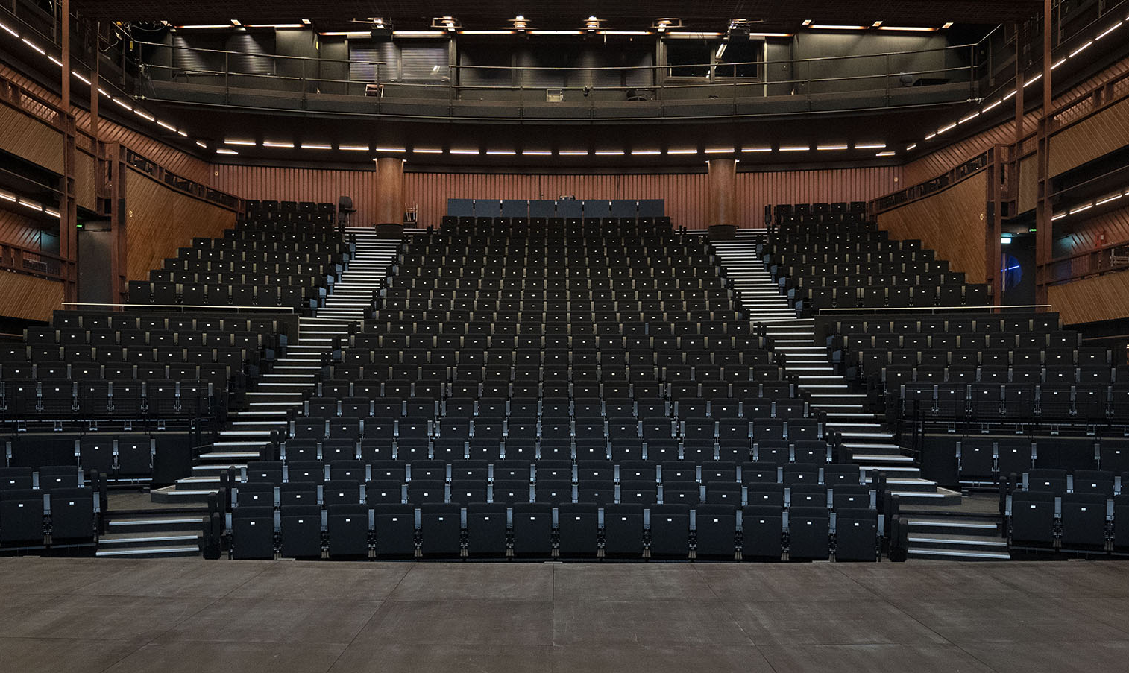
Our Domain

Slide 20
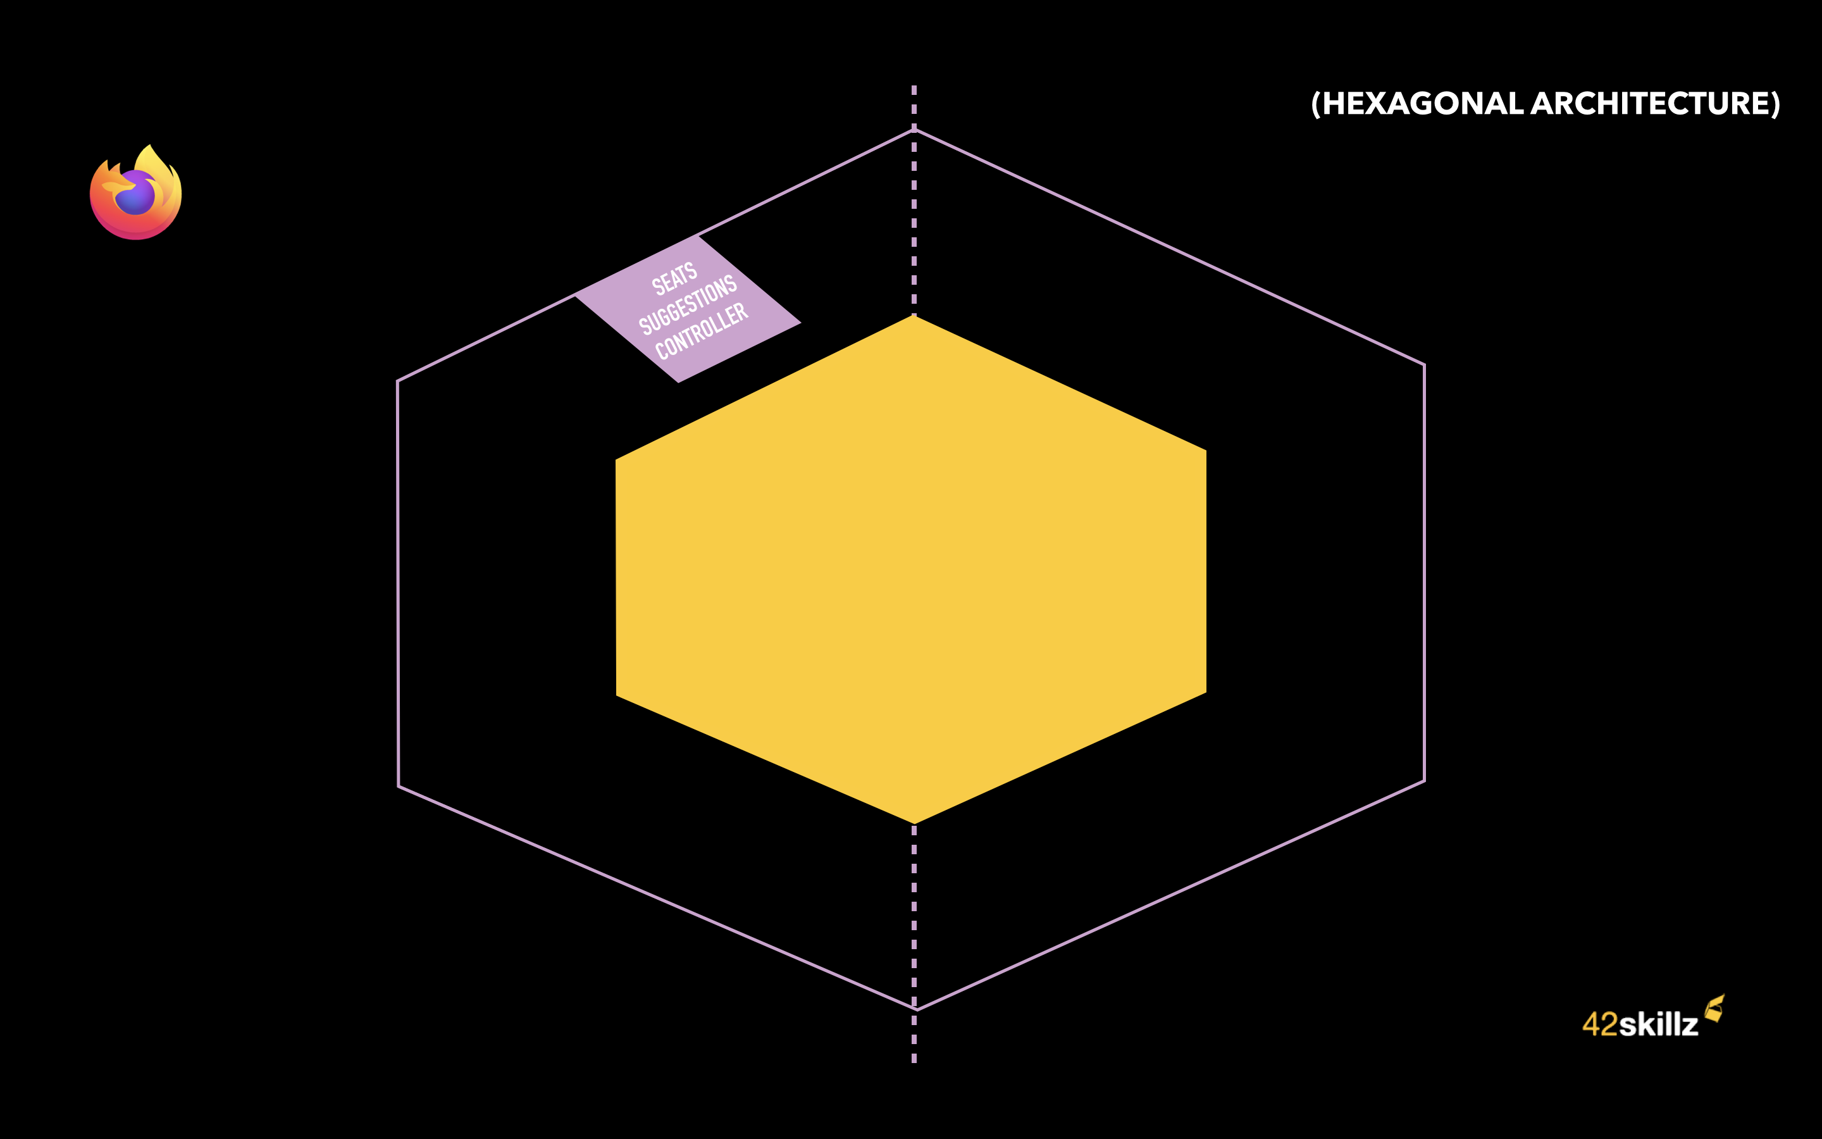
Suggesting seats in Theaters
“What seats can you suggest for 3 people wishing to attend the show Z?”
Notes:
Bruno – Ok. Let’s take an example. It all start with a request coming from a customer that is saying to our web site:
“I want to attend show Z and we are 3. What seats can you suggest to us?”

Slide 21
Suggesting seats in Theaters
“What seats can you suggest for 3 people wishing to attend the show Z?”
Seats Suggestions API
Notes:
Bruno – The request is sent to our API:
the SeatsSuggestions API in yellow

Slide 22
Suggesting seats in Theaters
“What seats can you suggest for 3 people wishing to attend the show Z?”
“I need the auditorium seating of show Z”
Auditorium Seating
API
Seats Suggestions API
Notes:
Bruno – What do we need for this job? We have to ask other backends for information, such as the show Z matching a specific auditorium seating (i.e., the theater's topology for this particular show).
Thomas - Yes, our API is making some API calls towards upstream systems handled by other teams and companies (here: the "AuditoriumSeating API").

Slide 23
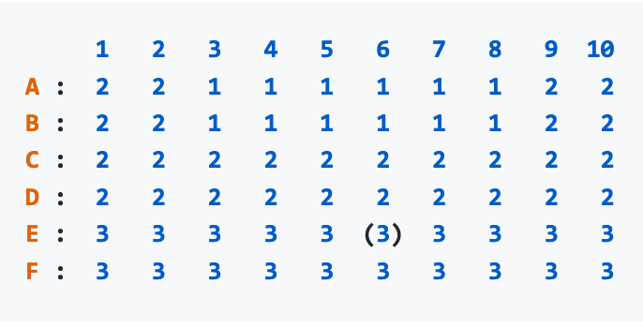
Suggesting seats in Theaters
“What seats can you suggest for 3 people wishing to attend the show Z?”
“I need the auditorium seating of show Z”
Auditorium Seating
API
Seats Suggestions API
Notes:
Bruno – When receiving our request, the Auditorium seating API is returning the auditorium topology for this show.
In other words, a list of rows, seats, corridors, pricing categories for every seat, etc.
(le prochain à parler sur le slide d’après sera Thomas)

Slide 24
Suggesting seats in Theaters
“What seats can you suggest for 3 people wishing to attend the show Z?”
“I need the auditorium seating of show Z”
Auditorium Seating
API
Seats Suggestions API
Notes:
Thomas - This external Auditorium seating API is not aware of which seats are free and which seats are already reserved.
Thomas - Our API in yellow must ask another backend: what are the available seats for this show?

Slide 25
Suggesting seats in Theaters
“What seats can you suggest for 3 people wishing to attend the show Z?”
“I need the auditorium seating of show Z”
Auditorium Seating
API
Seats Suggestions API
Seats Availability
API
“I also need to know which seats are already reserved for show Z”
Notes:
Bruno – You’re right. Hence this second call to another back-end: the “Seat availability API.”

Slide 26
Suggesting seats in Theaters
“What seats can you suggest for 3 people wishing to attend the show Z?”
“I need the auditorium seating of show Z”
Auditorium Seating
API
Seats Suggestions API
Seats Availability
API
“I also need to know which seats are already reserved for show Z”
Notes:
Bruno – Now that we have both:
The auditorium Layout and
For every seat- whether or not they are available (i.e. not reserved or reserved)
Our API in yellow can do its job.
Thomas - Which is… to find the best possible seats for this customer request.

Slide 27
Suggesting seats in Theaters
“What seats can you suggest for 3 people wishing to attend the show Z?”
“I need the auditorium seating of show Z”
Auditorium Seating
API
Seats Suggestions API
Seats Availability
API
“I also need to know which seats are already reserved for show Z”
OUR CORE DOMAIN
Notes:
Bruno – the core domain of our Seat suggestions API is really to suggest seats. We won't do the reservation, neither the booking.
Bruno- The booking part will be done afterward, with another system, by another API.
Bruno - To provide the best seats, we have rules, business rules such as:
Thomas - « do not separate parties of people; find them adjacent seats,»
Bruno - « whenever possible, try to locate them in the center of the row,»
Thomas - « try to suggest them expensive seats first » (because we have various pricing categories) etc.

Slide 28
Suggesting seats in Theaters
“What seats can you suggest for 3 people wishing to attend the show Z?”
“I need the auditorium seating of show Z”
Auditorium Seating
API
Seats Suggestions API
Seats Availability
API
“I also need to know which seats are already reserved for show Z”
Notes:
Bruno – So… We do our secret sauce to find and suggest the best possible seats for a show (here framed in yellow on the small diagram).
And then

Slide 29
Suggesting seats in Theaters
“What seats can you suggest for 3 people wishing to attend the show Z?”
“I need the auditorium seating of show Z”
Auditorium Seating
API
Seats Suggestions API
“Ok. You can have seats
A1, A2, A3 in pricing tier 1,
C4, C5, C6 in pricing tier 2
…”
Seats Availability
API
“I also need to know which seats are already reserved for show Z”
Notes:
Bruno – We return our various suggestions :
Thomas - Some are made for pricing tier 1 (the most expensive, generaly in the firts rows), some are made for pricing tier 2 (less expensive seats, etc).

Slide 30
Suggesting seats in Theaters
“What seats can you suggest for 3 people wishing to attend the show Z?”
“I need the auditorium seating of show Z”
Auditorium Seating
API
Seats Suggestions API
“Ok. You can have seats
A1, A2, A3 in pricing tier 1,
C4, C5, C6 in pricing tier 2
…”
Seats Availability
API
“I also need to know which seats are already reserved for show Z”
Notes:
Bruno –Yes. Our website will then suggest those options to the customer,
Thomas - Starting with the best and most expensive seats, of course!
Bruno – Yes Thomas, And that’s all we need to know about the domain for today.

Slide 32
Notes:
Thomas – Here is our hexagon in yellow. What you can see outside the hexagon but within the Infrastructure code boundaries is a left side adapter: the SeatsSuggestionsController.
Left-side adapters are kind of front doors for external users to ask questions to our component, to send queries, commands, request, etc.
Here, our main front door will be an ASP.NET web controller (because our example will be in C#).

Slide 33
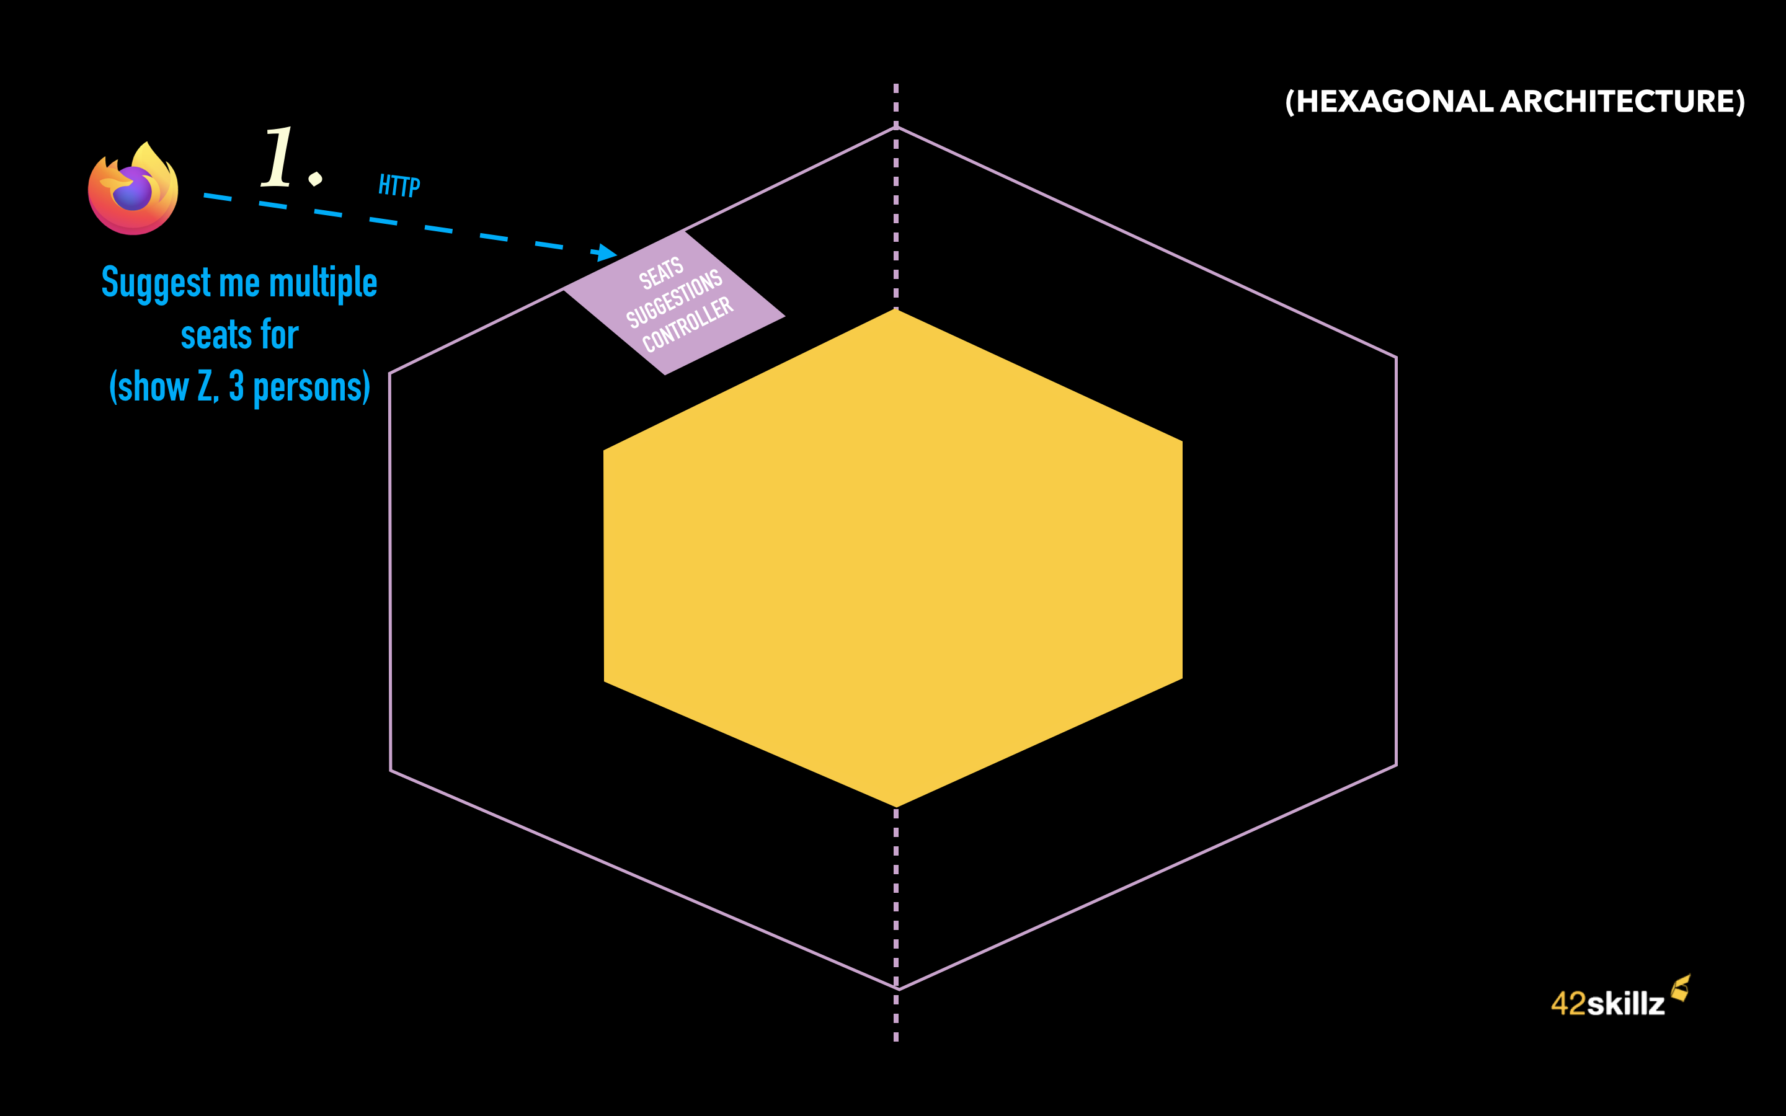
Notes:
Thomas – So. Our React web site, the front-end part will send us an HTTP GET request.
Something like: on a SeatsSuggestions resource => to query string suggestions for ShowId = Z and a party of 3 persons.
// GET api/SeatsSuggestions?showId=5&party=3

Slide 34
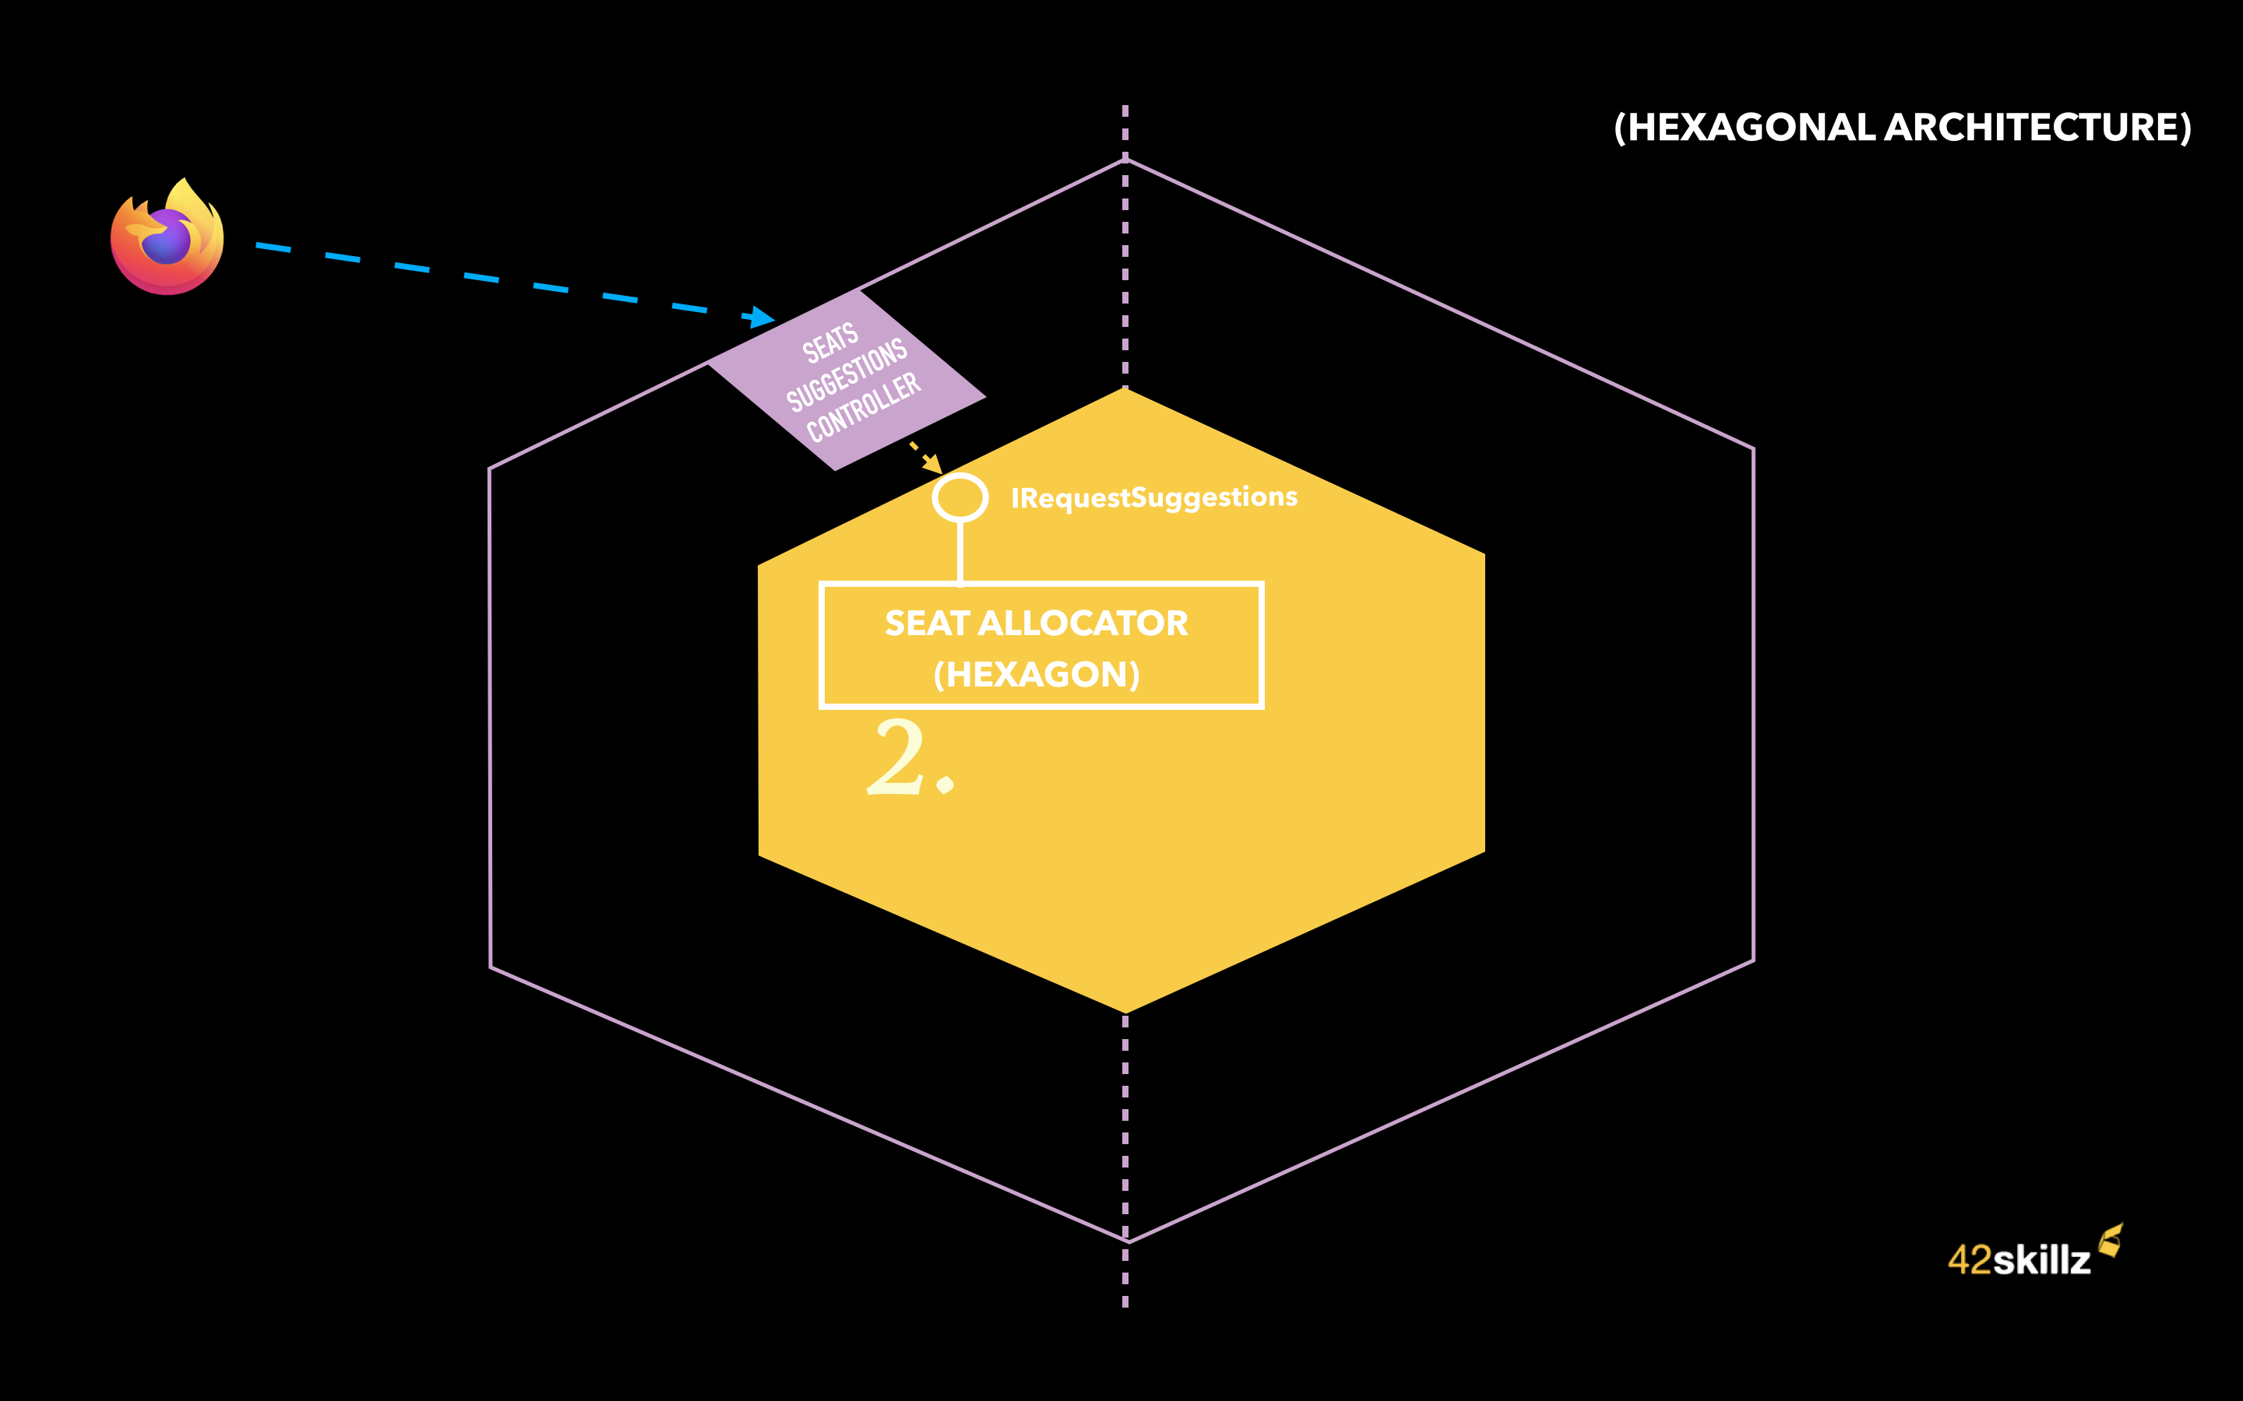
Notes:
Thomas – This request is handled at our WebController level, which is ALSO our left-side Adapter (here in light-purple)
This WebController/Adapter will do something every left-side adapters do:
1. Adapt from Infra data model (here JSON or HTTP querystring) to Domain types and data structure
2. Call the Domain code (the hexagon) using a left-side port method (here the left side port is the interface: IRequestSuggestions , and the method will be its MakeSuggestions() method)
3. Adapt back the answer coming from the Domain (here a SuggestionssssssMade data type) to something that will fit the corresponding infra layer : here an HTTP response (with HTTP Code, content etc)
This is the overall process. But let’s zoom into the various steps now.
The WebController will call the MakeSuggestions() method of the Hexagon (And the name of the Hexagon is SeatAllocator)

Slide 35
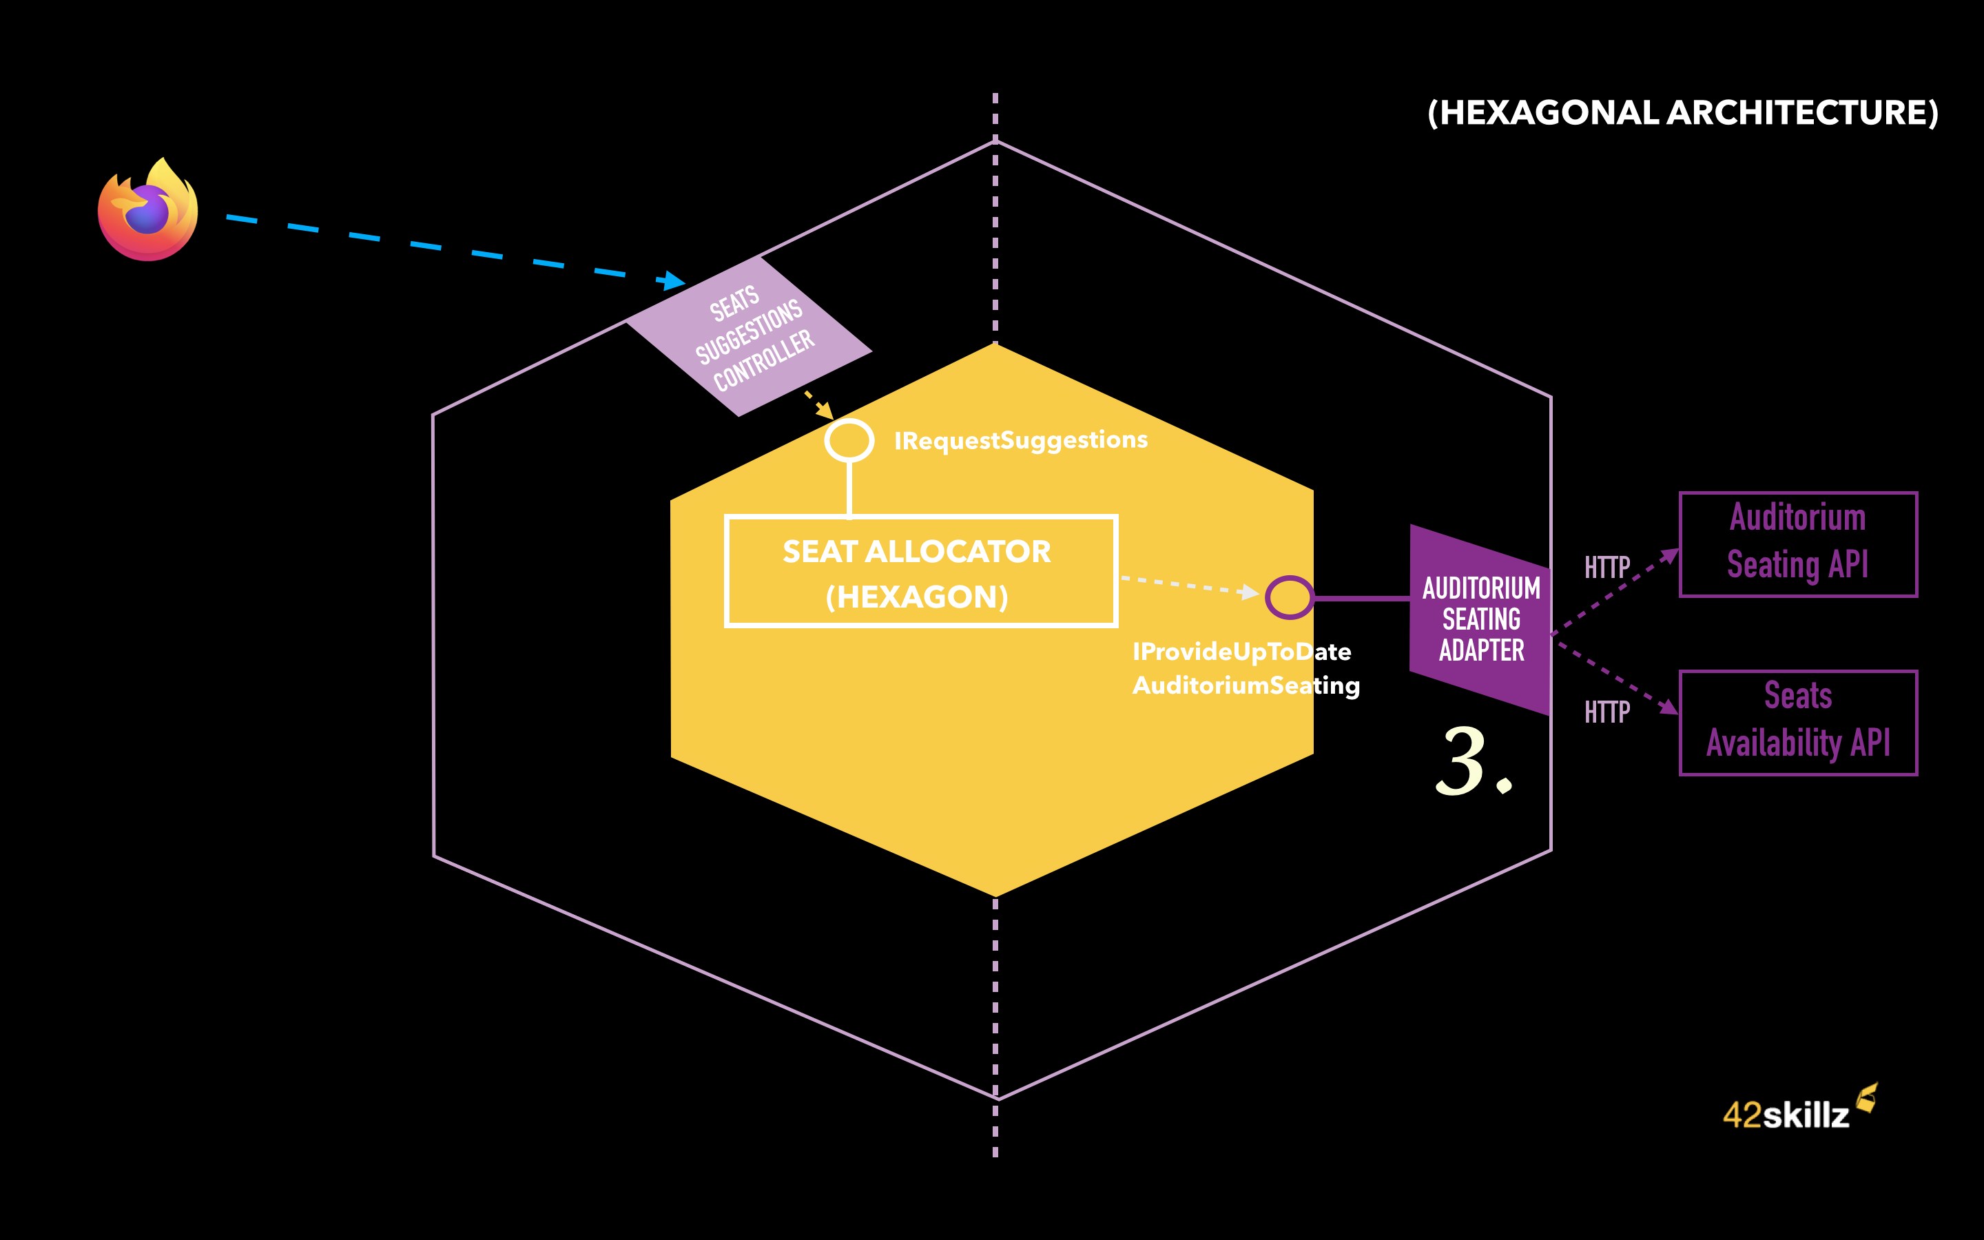
Notes:
Thomas – In order to suggest the best Seats, the SeatAllocator has to work with an AuditoriumSeating.
In other word:
the Theater topology for this show
The list seats that are already reserved for this show
Before being able to work with, our hexagon -the SeatAllocator- will first ask some information to the outside world (here 2 external APIs on the right : Auditorium Seating API & Seats Availability API).

Slide 36
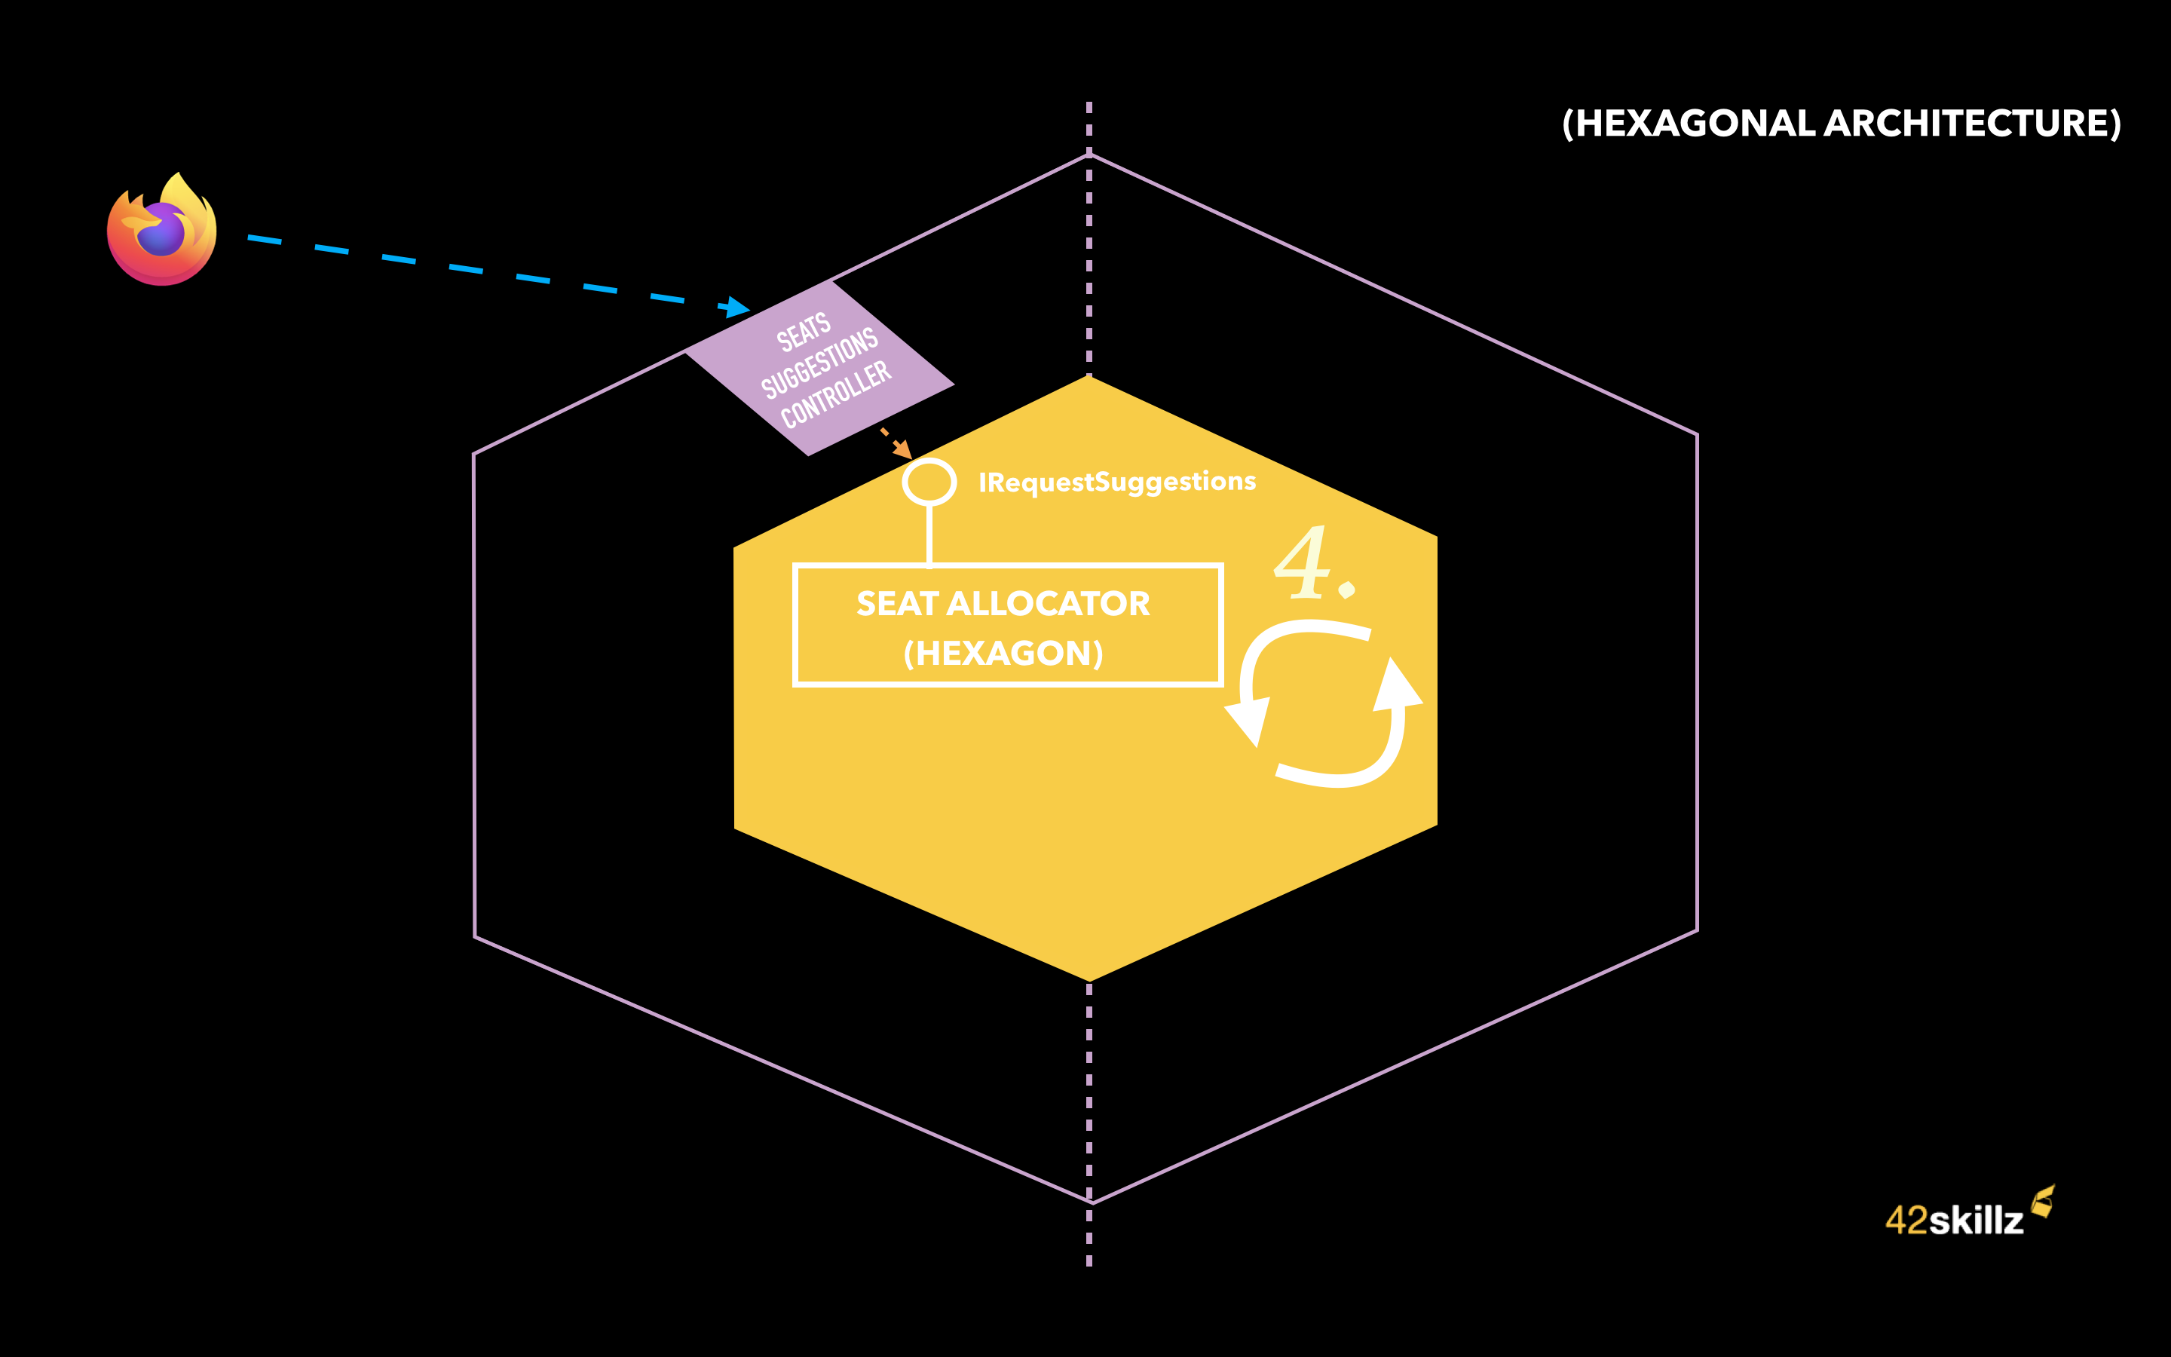
Notes:
Then the hexagon can do its own job which is to find and suggest the best possible combination of seats for this show and this number of people.

Slide 37
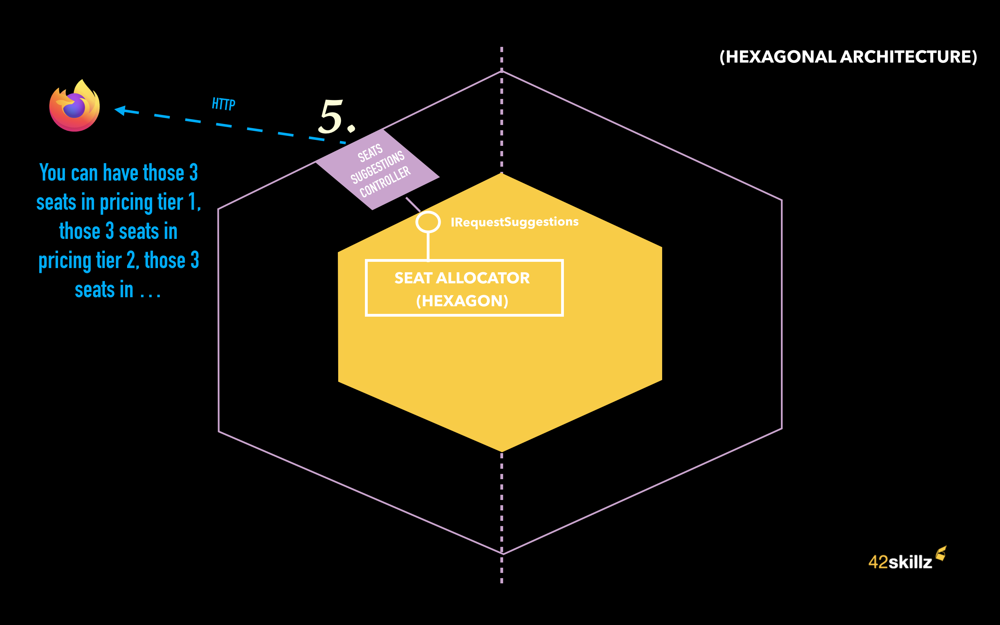
Notes:
And finally, returning the result which is something like : “you can have those 3 seats in pricing tier 1, those 3 other seats in pricing tier 2 etc.

Slide 38

Notes:
Thomas – Let’s sum-up:
A request is coming from the web site on the left, handled by a web controller which is our left side adapter here.
This left side adapter is calling the hexagon through a IRequestSuggestions port belonging to our domain and implemented by the Seat Allocator type.
The SeatAllocator type from our domain will need first to get an up-to-date AuditoriumSeating. It will ask it through a right-side port named IProvideUpToDateAuditoriumSeating (implemented by a right-side port in purple: the AuditoriumSeatingAdapter). This one will fetch Auditorium Layout in one hand and the list of already reserved seats in the other hand in order to merge them into what we call an up-to-date AuditoriumSeating (meaning: for every seat, you know if it’s already reserved or not)
Then our business logic can work and will do the job of finding best seats
Our left-side adapter will get the answer from our SeatAllocator, Adapt it to an HTTP response, and forward it to our client

Slide 39
Let’s see some code

Slide 41
Menu
Original pattern
Alternate takes (DDD friendly)
Notes:
This session will present both the original pattern in detail, and some alternative versions (related to Domain Driven Design).

Slide 42
Menu
Original pattern
Alternate takes (DDD friendly)
Notes:
Ok.Let’s continue with the alternate takes of the pattern.

Slide 43
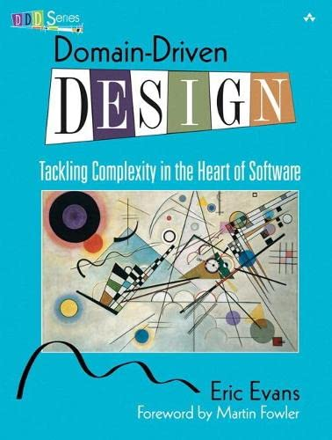
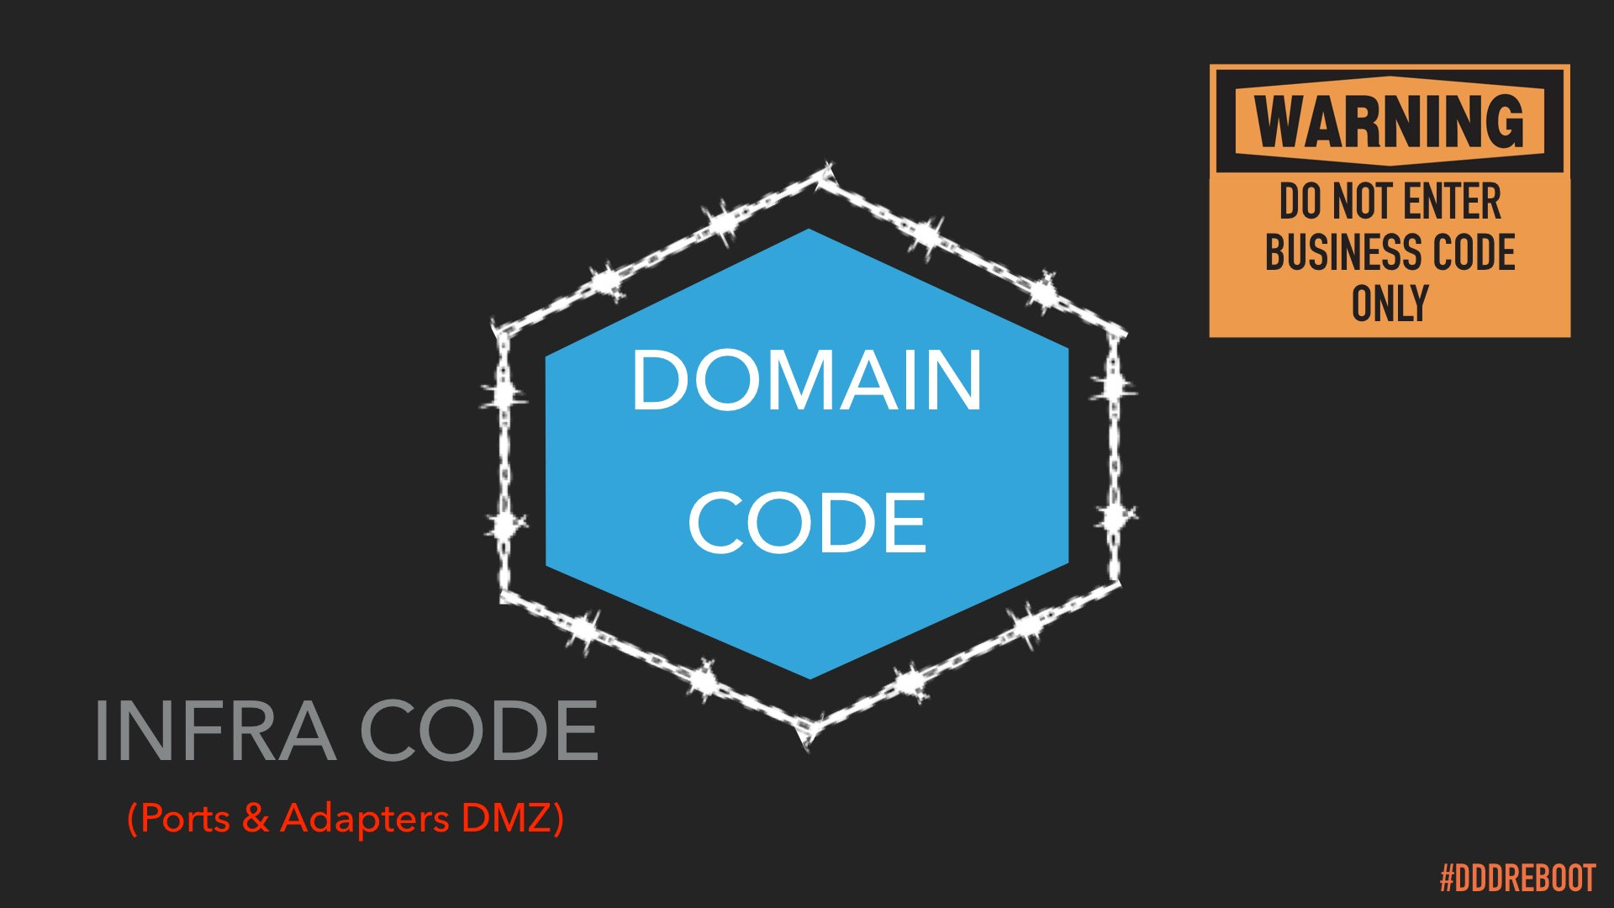
Other intents #1
community
To properly split and protect our domain code from the infrastructure one

Slide 44
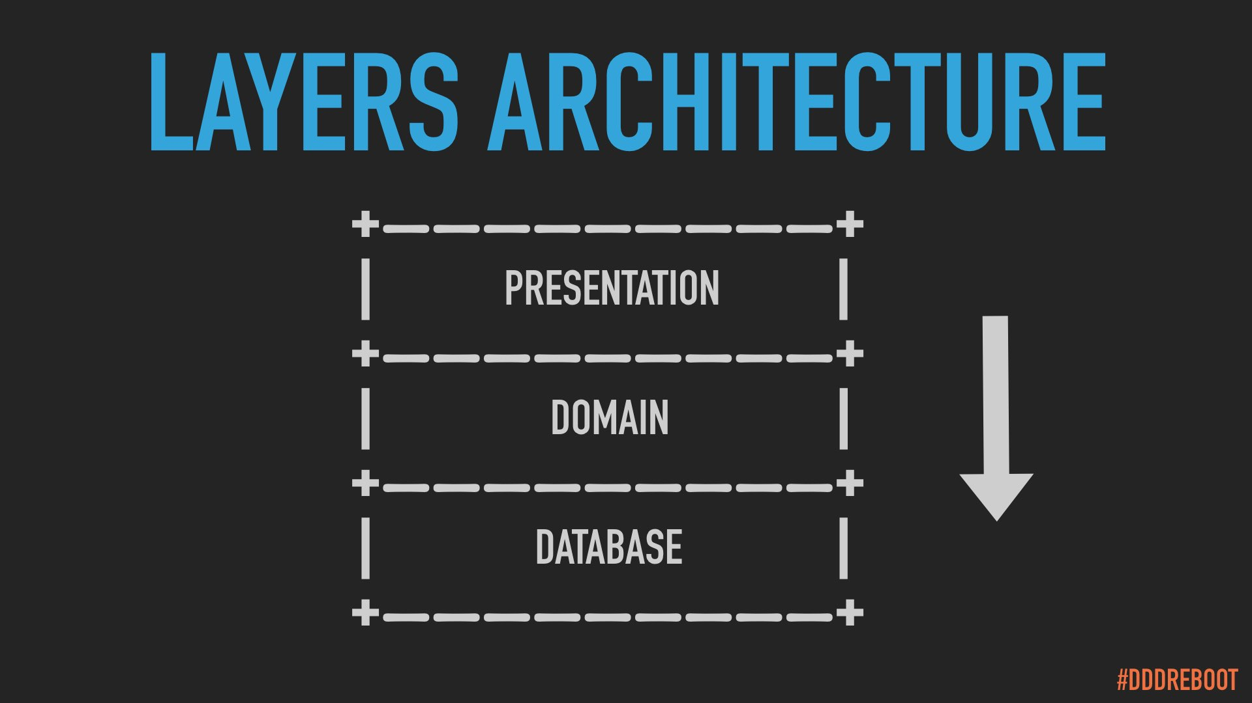
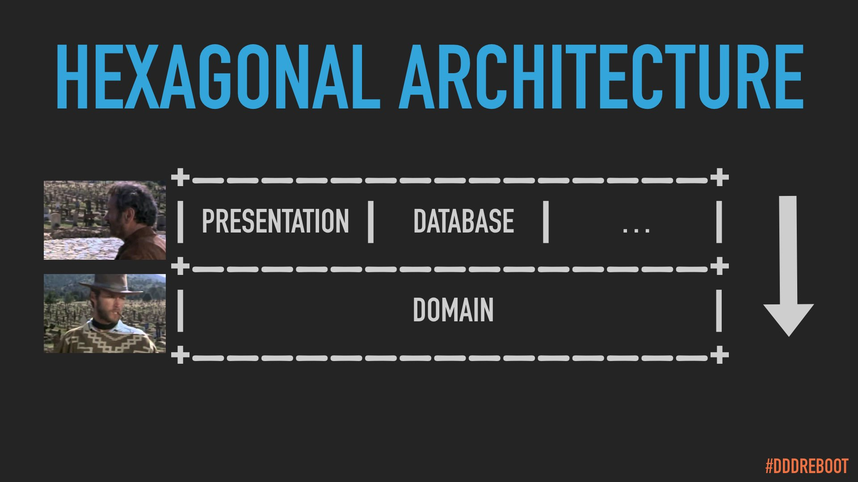
Other intents #2
community
To reduce layering and complexity of our “baklava” architectures

Slide 45

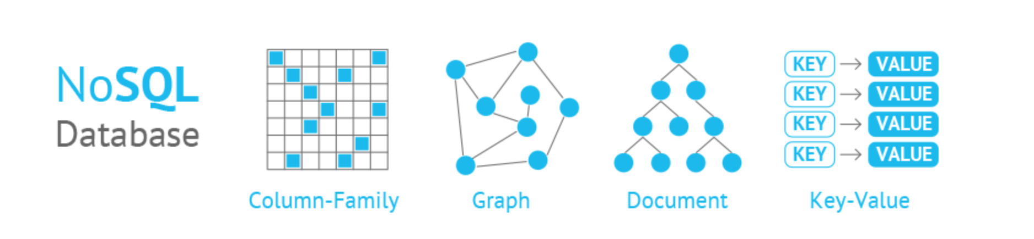
Other intents #3
community
To postpone architecture decision at the right time (when we understand the domain & our constraints)

Slide 46
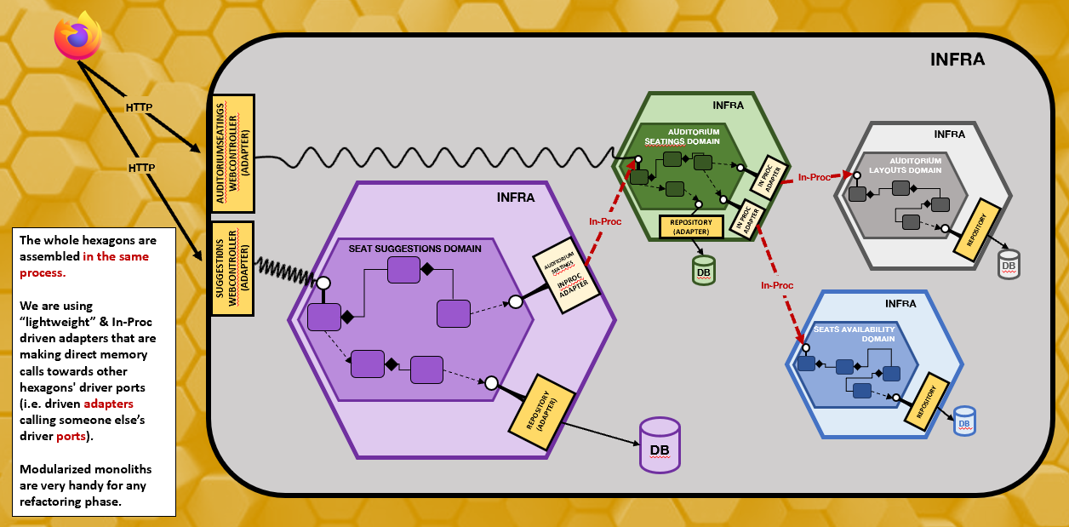
Other intents #4
community
To modularize a monolith and get ready for a physical split among various components/apis/μ services
Notes:
A Bounded Context (BC) is a linguistic and conceptual boundary where words, people and models that apply are consistent and used to solve specific Domain problems. Specific problems of business people who speak the same language and share the same concerns (e.g. the Billing context, the Pre-sales context...)
DDD recommends for every BC to have its own models, taylor-made for its own specific usages

Slide 47
The hive - Modular monolith with “hexagons” inside
@tpierrain (use case driven) 2.2
Infra
HTTP
Infra
AuditoriumSeatings WebController (Adapter)
Auditorium seatings Domain
Infra
HTTP
Auditorium Layouts Domain
In Proc Adapter
In-Proc
Infra
In-Proc
Repository (adapter)
In Proc Adapter
repository
The whole hexagons are assembled in the same process.
We are using “lightweight” & In-Proc driven adapters that are making direct memory calls towards other hexagons' driver ports (i.e. driven adapters calling someone else’s driver ports).
Modularized monoliths are very handy for any refactoring phase.
Seat suggestions Domain
Suggesti0ns WebController (Adapter)
Auditorium seatingS
Inproc Adapter
db
db
In-Proc
Infra
Seats Availability DOMAIN
Repository (Adapter)
repository
db
db

Slide 48
The split - “Micro” services powered by hexagonal architecture
@tpierrain (use case driven)
IProvideUpToDateAuditoriumSeatings (driven port)
Infrastructure
Infra
HTTP
Web controller
Auditorium Layouts Domain
WebController (Adapter)
Seat suggestions Domain
(in proc)
Repo (adapter)
db
Infra
Auditorium seating web Adapter
Web controller
Auditorium seating Domain
HTTP
HTTP
Repository (Adapter)
web Adapter
Repo (adapter)
web Adapter
db
HTTP
Infra
Seat SuggestionS API
db
Web controller
Seats Availability DOMAIN
The next step after a monolith modularization is often to split the various hexagons into dedicated services/APIs.
But beware of the Distributed Monolith pitfall occurring very often when the services/APIs aren’t aligned with (sub) domain concerns (see. Bounded Contexts from DDD).
Repo (adapter)
db

Slide 49
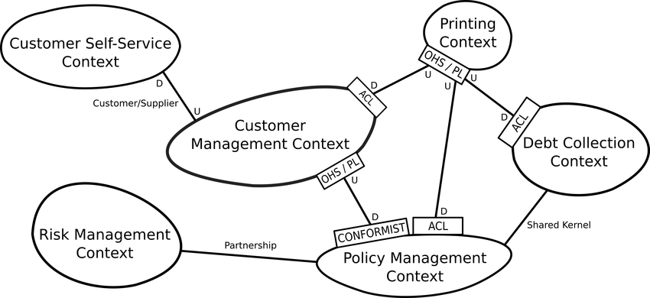
Other intents #5
community
To adapt not only technologies but also external models
Notes:
A Bounded Context (BC) is a linguistic and conceptual boundary where words, people and models that apply are consistent and used to solve specific Domain problems. Specific problems of business people who speak the same language and share the same concerns (e.g. the Billing context, the Pre-sales context...)
DDD recommends for every BC to have its own models, taylor-made for its own specific usages

Slide 50
Hexagonal “hacked” with an Anti-corruption layer (ACL) adapter
@tpierrain (use case driven)
IProvideUpToDateAuditoriumSeatings (driven port)
Infrastructure
Infra
HTTP
Web controller
Auditorium Layouts Domain
WebController (Adapter)
Seat suggestions Domain
(in proc)
Repo (adapter)
HTTP
db
Auditorium seating ACL (Adapter)
Provides Auditorium layout (Topology) for a show, but with no information about seats availabilities
HTTP
db
Repository (Adapter)
Infra
db
Web controller
Seats Availability DOMAIN
Seat SuggestionS API
The AuditoriumSeatings ACL (in green) exposes us ready-to-use Auditorium Seatings for shows. It assembles them from various external sources/APIs. An Auditorium Seating is the Auditorium Layout for a show, with indications about every current seat availability.
Interesting option/trade-off when we don’t want to couple our real core domain (i.e. to suggest the best possible seats for groups of people) with how to infer Auditorium Seatings from various external sources and models. More about it (Hexagonal or not Hexagonal?) : https://tpierrain.blogspot.com/2020/11/hexagonal-or-not-hexagonal.html
Repo (adapter)
db
Provides list of already reserved seats for a show

Slide 51
The split - “Micro” services powered by hexagonal architecture
@tpierrain (use case driven)
IProvideUpToDateAuditoriumSeatings (driven port)
Infrastructure
Infra
HTTP
Web controller
Auditorium Layouts Domain
WebController (Adapter)
Seat suggestions Domain
(in proc)
Repo (adapter)
db
Infra
Auditorium seating web Adapter
Web controller
Auditorium seating Domain
HTTP
HTTP
Repository (Adapter)
web Adapter
Repo (adapter)
web Adapter
db
HTTP
Infra
Seat SuggestionS API
db
Web controller
Seats Availability DOMAIN
The next step after a monolith modularization is often to split the various hexagons into dedicated services/APIs.
But beware of the Distributed Monolith pitfall occurring very often when the services/APIs aren’t aligned with (sub) domain concerns (see. Bounded Contexts from DDD).
Repo (adapter)
db

Slide 52
Hexagonal or not hexagonal?
-Yes-
An Adapter can be an ACL
I may not want my domain to be polluted by external models or upstream organizational changes
-NO-
I want to stick to Alistair original motivations (i.e. technological) ⬄ port = only to swap technology
Notes:
Second answer: NO….
We will let you think about it for one minute.
Thomas – Kenny: can you please start the poll so that the audience can answer to the question?

Slide 53
Hexagonal or not hexagonal?
And Now?
Note: an external API is often a former module extracted from a modular monolith
AuditoriumSeating API
Notes:
Second answer: NO….
We will let you think about it for one minute.
Thomas – Kenny: can you please start the poll so that the audience can answer to the question?

Slide 54
Hexagonal Architecture: one pattern, multiple facets?
The technological facet: to easily switch one technology with another without breaking our core domain code (like plug-ins)
The testability facet: to easily develop and test an application in isolation from its eventual run-time devices and databases
The fast feedback facet: to have good time to market and fast feedbacks about what is really at stakes for our users
Community
The tactical DDD facet: to properly split and protect our domain code from the infrastructure one
The simplicity facet: to reduce layering and complexity of our architectures
The late architectural decisions facet: to postpone architectural decisions at the right time
The strategic DDD facet: to adapt not only technologies but also external models
The Refactoring hive facet: to modularize a monolith splitting every Bounded Context into a hexagon

Slide 55
So…

Slide 56
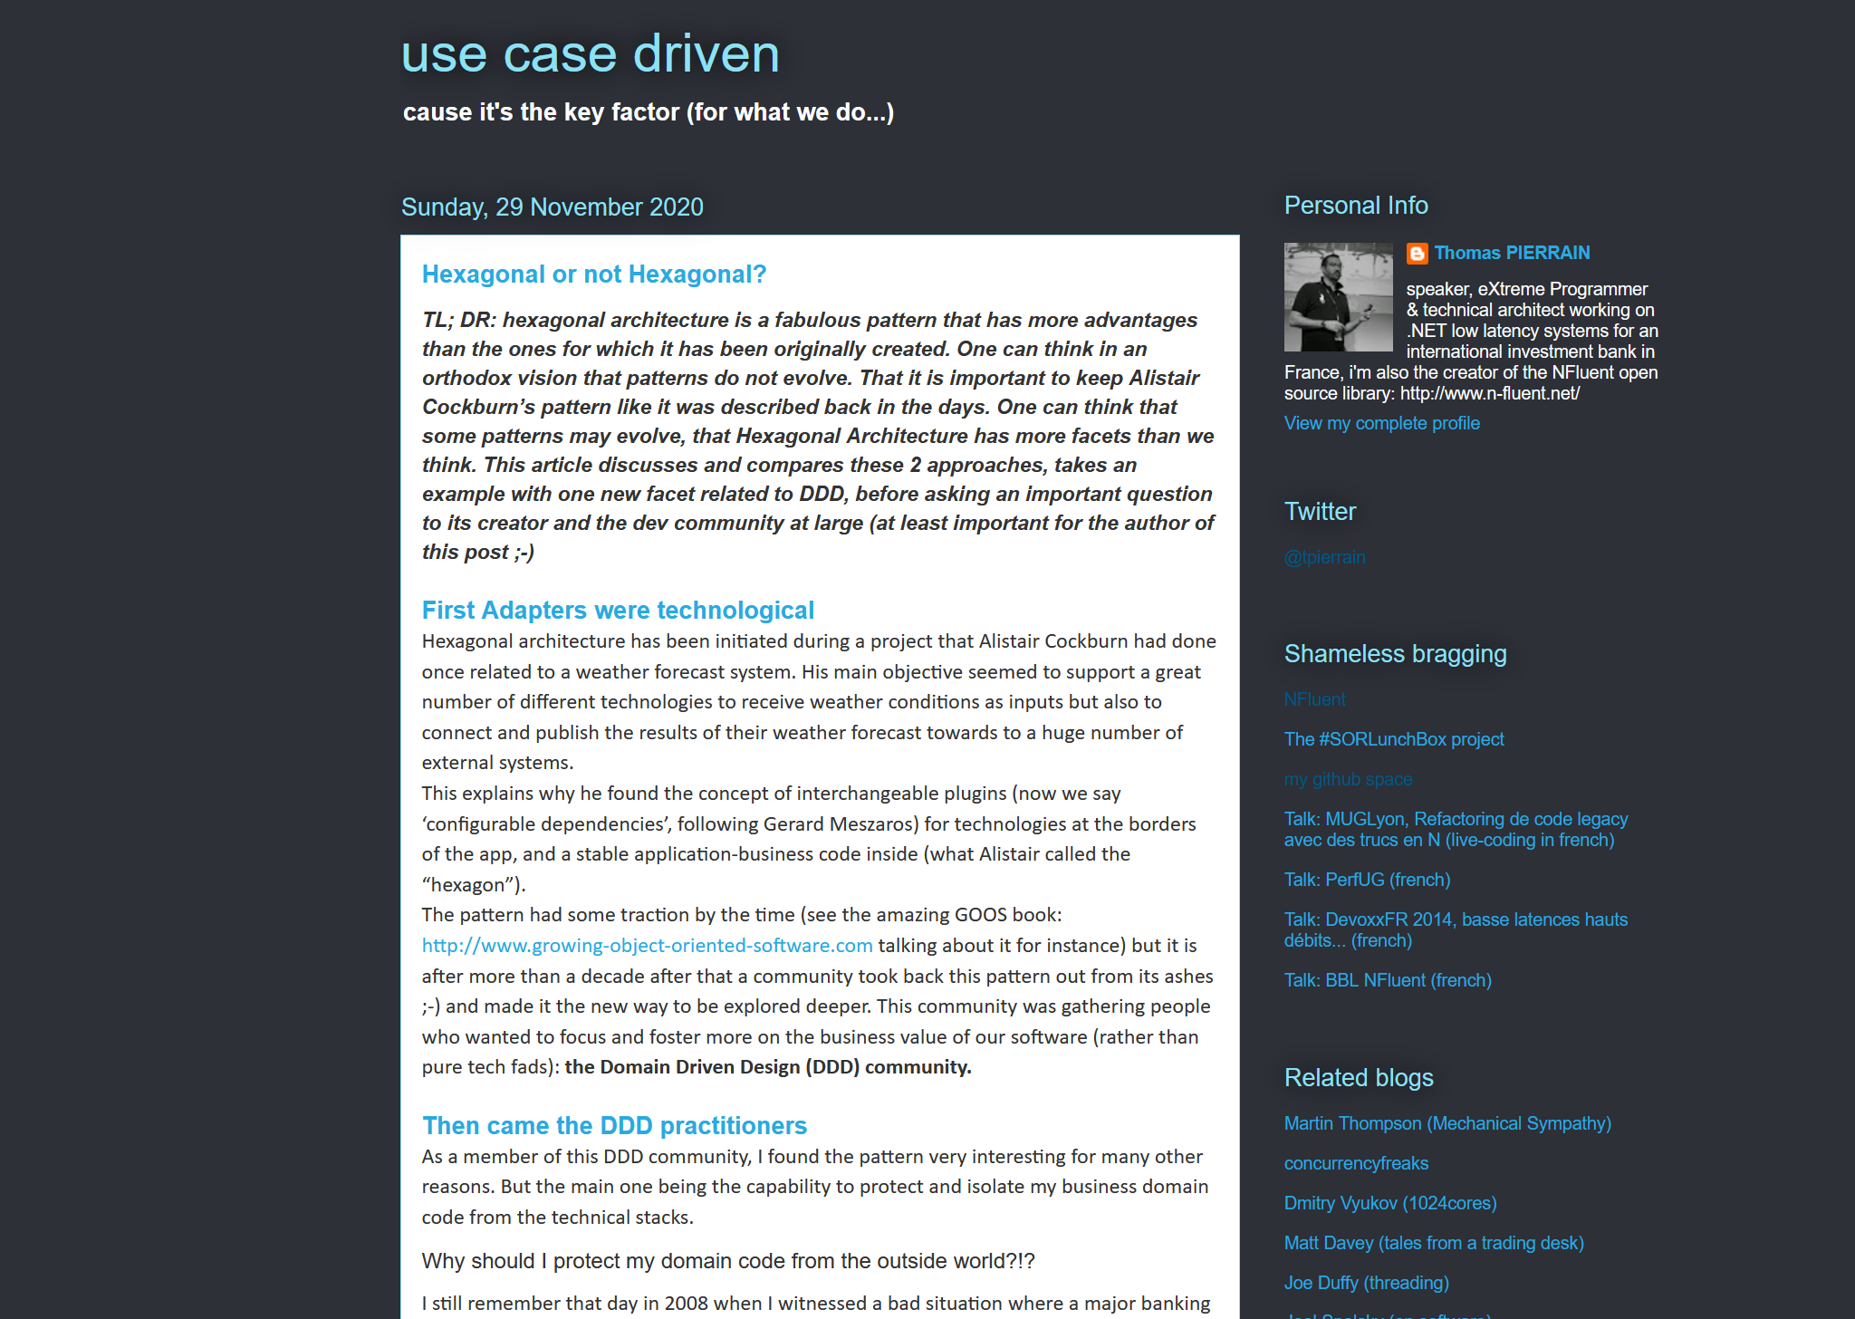
Hexagonal or not hexagonal?
Yes ?
It’s a multi-facets pattern!
The technological facet
The testability facet
The tactical DDD facet
The simplicity facet
The quick feedback facet
The late architectural decisions facet
The strategic DDD facet
Notes:
Thomas – Following some discussion on twitter a couple of months ago, I wrote an article saying : YES
Yes, for me Hexagonal Architecture has became an Umbrella term nowadays. Especially in the Domain Driven Community
The fuzziness of Alistair’s original article has something in common with Eric Evan's Blue Book.
It’s so conducive to various interpretations that it ages really well.
It’s a multi-facet pattern.
One may have the same need as Alistair and pick it for its technological plugins capabilities
One may pick it for testing, like Steve Freeman & Nat Pryce in their tremendous GOOS book
Another one may -like me- pick it because it allows us to protect our domain code from the infrastructure one. What I called the Tactical DDD facet
Another one may –again like me- pick it because it allows us not to have too many layers. Only 2: infra / domain. What I called the Simplicity facet
Another one may pick it in order to have quick feedback; focusing on the domain first and seeing some decision lately, once we know what we need as data store, data base & stuffs
Another one may – like me or Julien Topçu- pick it because it allows us to put some strategic DDD and ACLs in right-side adapters. What I called the Strategic DDD facet.
See?!? This pattern may be chosen for so many reasons, providing so many tradeoffs and options.. That I really think one should continue to use it BEYOND the pure and original technological facet.
And if the community do not agree. If one think it should just remain a way of switching technologies with plug-ins like originally stated by Alistair. We will need to ask ourselves how to name all these facets that –WE- the DDD community used to play with since so many years

Slide 57
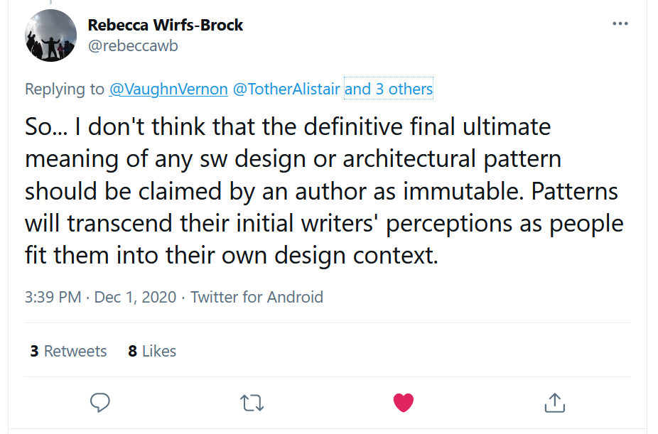
Hexagonal or not hexagonal?
Notes:
And as stated by Rebecca Wirfs-Brock during our discussions on twitter with Alistair, Vaughn, Juan Garrido Paz and Matt Wynne:
“Patterns will transcend their initial writer’s perceptions as people fit them into their own design context”
Tweet:
https://twitter.com/rebeccawb/status/1333782730732048387?s=20

Slide 58
And if we finally vote no…
As a community, we will have to find new name(s) for all our usages
Notes:
Thomas - And if we finally vote no…
The DDD community will have to find new name(s) for all our usages
But I’m not worried… because this is something the DDD community is kind of expert in: searching the best possible names for thing ;-)

Slide 59
Thank you!
Questions?

Slide 60
Appendix

Slide 61
Hexagonal “Micro” services
@tpierrain (use case driven)
IProvideUpToDateAuditoriumSeatings (driven port)
Infrastructure
Infra
HTTP
Web controller
Auditorium Layouts Domain
WebController (Adapter)
Seat suggestions Domain
(in proc)
Repo (adapter)
db
Infra
Auditorium seating web Adapter
Web controller
Auditorium seating Domain
HTTP
HTTP
Repository (Adapter)
web Adapter
Repo (adapter)
web Adapter
db
HTTP
Infra
Seat SuggestionS API
Provides AuditoriumSeatings (AuditoriumSeating = Auditorium layout for the show with current availabilities mapped for every seat)
db
Web controller
Seats Availability DOMAIN
The next step after the initial version of the ACL providing the AuditoriumSeating is often to extract it and make it a dedicated service/API for multiple consumers to consume it.
One will notice that our IProvideUpToDateAuditoriumSeatings driven port hasn’t changed since the initial version.
Repo (adapter)
db

Slide 62

Hexagonal “hacked” with an Anti-corruption layer (ACL) adapter
@tpierrain (use case driven)
Infrastructure
IProvideUpToDateAuditoriumSeatings (driven port)
Infra
HTTP
Web controller
Auditorium Layouts Domain
WebController (Adapter)
Seat suggestions Domain
(in proc)
Repo (adapter)
HTTP
db
Auditorium seating ACL (Adapter)
Provides Auditorium layout (Topology) for a show, but with no information about seats availabilities
HTTP
db
Repository (Adapter)
Infra
db
Web controller
Seats Availability DOMAIN
Seat SuggestionS API
The AuditoriumSeatings ACL (in green) exposes us ready-to-use Auditorium Seatings for shows. It assembles them from various external sources/APIs. An Auditorium Seating is the Auditorium Layout for a show, with indications about every current seat availability.
Interesting option/trade-off when we don’t want to couple our real core domain (i.e. to suggest the best possible seats for groups of people) with how to infer Auditorium Seatings from various external sources and models. More about it (Hexagonal or not Hexagonal?) : https://tpierrain.blogspot.com/2020/11/hexagonal-or-not-hexagonal.html
Repo (adapter)
db
Provides list of already reserved seats for a show

